Slide 1
2D game data
Course : 2D Game Programming
Effective Period : September 2018

Slide 2
These slides have been adapted from: Pereira, V. (2014). Learning Unity 2D Game Development by Example, Packt Publishing, Inc. San Francisco. ISBN: 9781783559046 Chapter 10
Acknowledgement

Slide 3
Learning Objectives
LO 1 : Create 2D game for PC platform
LO 2 : Apply best practices of 2D game development
LO 3 : Design 2D game for PC platform

Slide 4
Outline Material
Save Data
PlayerPrefs
Save to Text File

Slide 5
Save Data
How and in what format to save the data. As usual, there are many options, with different pros and cons. A nice feature of adventure-type games is that the saved games don’t have to be secure against the player breaking in and changing values

Slide 6
PlayerPrefs
It saves the data in its native format as integers, floats, or strings. The syntax is similar to the parameters you used in Mecanim for the two characters. To save a value, you use the appropriate type for the data, SetFloat, SetInt, or SetString, followed by the parameter name, in quotation marks, and the value, separated by a comma.
For example: PlayerPrefs.SetFloat("Player Score", 10.0).
To retrieve the data, you would use PlayerPrefs.GetFloat("Player Score").
You would have to check for the existence of the key (the name representing that data), before trying to retrieve it.

Slide 7
Text files
The advantages are: you can store multiple saved games while you are developing; they are easy to inspect; and they can be moved between different computers. With some extra work, you could allow the player to save and load as many files as he chooses, providing you create a save/load screen to handle them.
Use Application.dataPath to get the project location and add the filename to create file on your project
There are many ways to read and write file using c#. The simple ways is use SteamWriter to write and SteamReader to read.
You can add encryption to your data to secure data. The simple encryption method is using shift method (>> or <<) or try another method

Slide 8
Text files (cont)
While using text files, you can save all data. Just put some character to separate them (usually using semicolon “;” or hashtag “#”)
Example: you can save your character status on single line:
Format: name;hp;mp;strength;agility;intelligent
Data: Zeratul;1600;570;54;33;12

Slide 9
I am PlayerPrefs and I am helping
PlayerPrefs Class allow us to store 3 simple data types:
float
int
string
On the one side it seems to be a small possibilities for us but it’s enough to do basic operations. Data is stored like in associative array – an abstract data type composed of a collection of pairs (key, value). What is important that each possible key appears at most once in the collection. Let’s do some practice!

Slide 10
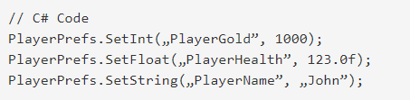

Saving data
If you want to save the data using PlayerPrefs Class you will use one of static method below. Choose method according to data type which you want to save.
Once you have set this data you should save it. Now, You can do it manually by method:

Slide 11
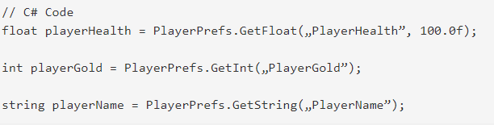

Loading data
Loading is similar to saving – to load certain value simply use it unique key to find it
Sometimes we need to know if given key exists. There is a very helpful method – HasKey()

Slide 12


Removing data
The last of functionalities which PlayerPrefs class offers is removing entries from stored data. You can remove selected key-value pair by method
Also, You can remove all entries by

Slide 13
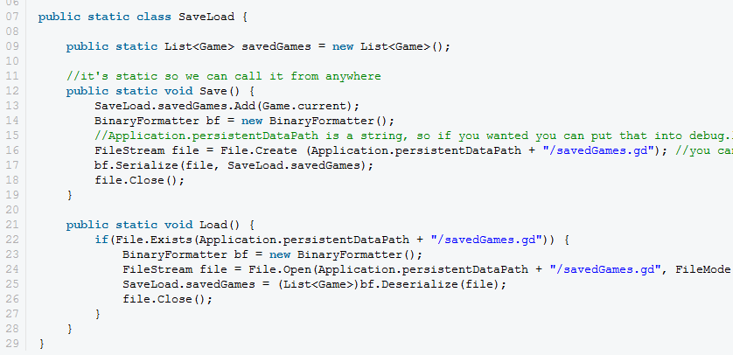
Not int, float and String?

Slide 14
What your team need to do?
Create a public facebook post promoting your game and please use #BINUSGAT
Example:
“Try out our game’s prototype ‘Plastic Runner’ an endless platformer by simply visiting itch.io/PlasticRunner. Don’t forget to rate the game and give us input. #BINUSGAT ”

Slide 15
Discussion
Discuss with your team members what kind of data that you are going to use for your game.

Slide 16
References
Freeman, J. (2015). Unity’s New 2D Workflow
Vidyasagar. (2014. Unity and C#: Game Loop.CodeProject
Pereira, V. (2014). Learning Unity 2D Game Development by Example. Packt Publishing, Inc. San Francisco. ISBN: 9781783559046
Unity. (2016). Unity Documentation. http://docs.unity3d.com/Manual/
Daily, E. (2014). How to Save and Load Your Players' Progress in Unity. Envatotuts. http://gamedevelopment.tutsplus.com/tutorials/how-to-save-and-load-your-players-progress-in-unity--cms-20934

